Slide 1

SPARK

Slide 2
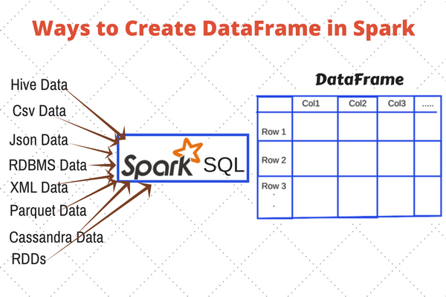
CONTENTS
Introduction to DataFrames
Entry point: SparkSession
Creating DataFrames

Slide 3
Introduction to DataFrames
DataFrame appeared in Spark Release 1.3.0.
We can term DataFrame as Dataset organized into named columns.
DataFrames are similar to the table in a relational database or data frame in R /Python.
It can be said as a relational table with good optimization technique.
The idea behind DataFrame is it allows processing of a large amount of structured data.

Slide 4
DataFrame contains rows with Schema. The schema is the illustration of the structure of data.
DataFrame in Apache Spark prevails over RDD but contains the features of RDD as well.
The features common to RDD and DataFrame are immutability, in-memory, resilient, distributed computing capability.
It allows the user to impose the structure onto a distributed collection of data.
Thus provides higher level abstraction.

Slide 5
We can build DataFrame from different data sources.
For Example structured data file, tables in Hive, external databases or existing RDDs.
The Application Programming Interface (APIs) of DataFrame is available in various languages.
Examples include Scala, Java, Python, and R.
Both in Scala and Java, we represent DataFrame as Dataset of rows.
In the Scala API, DataFrames are type alias of Dataset[Row].
In Java API, the user uses Dataset<Row> to represent a DataFrame.

Slide 6
Why Dataframe?
DataFrame is one step ahead of RDD.
Since it provides memory management and optimized execution plan.
a. Custom Memory Management
This is also known as Project Tungsten.
A lot of memory is saved as the data is stored in off-heap memory in binary format.

Slide 7
Apart from this, there is no Garbage Collection overhead.
Expensive Java serialization is also avoided. Since the data is stored in binary format and the schema of memory is known.
b. Optimized Execution plan
This is also known as the query optimizer. Using this, an optimized execution plan is created for the execution of a query.
Once the optimized plan is created final execution takes place on RDDs of Spark.

Slide 8
Features of DataFrame
Some of the limitations of Spark RDD were-
It does not have any built-in optimization engine.
There is no provision to handle structured data.
Thus, to overcome these limitations the picture of DataFrame came into existence.

Slide 9
Some of the key features of DataFrame in Spark are:
i. DataFrame is a distributed collection of data organized in named column. It is equivalent to the table in RDBMS.
ii. It can deal with both structured and unstructured data formats. For Example Avro, CSV, elastic search, and Cassandra. It also deals with storage systems HDFS, HIVE tables, MySQL, etc.
iii. Catalyst supports optimization. It has general libraries to represent trees. DataFrame uses Catalyst tree transformation in four phases:
Analyze logical plan to solve references

Slide 10
Logical plan optimization
Physical planning
Code generation to compile part of a query to Java bytecode.
iv. The DataFrame API’s are available in various programming languages. For example Java, Scala, Python, and R.
v. It provides Hive compatibility. We can run unmodified Hive queries on existing Hive warehouse.

Slide 11
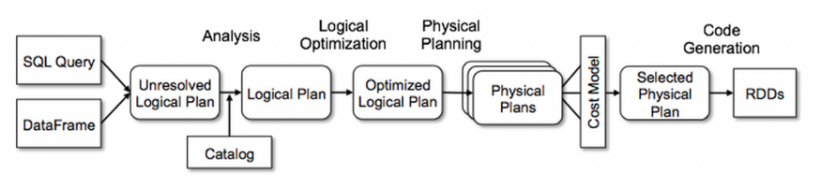
vi. It can scale from kilobytes of data on the single laptop to petabytes of data on a large cluster.
vii. DataFrame provides easy integration with Big data tools and framework via Spark core.

Slide 12
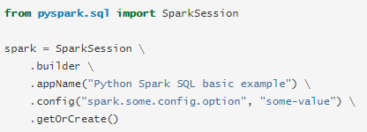
Entry Point: SparkSession
PYTHON
The entry point into all functionality in Spark is the SparkSession class.
To create a basic SparkSession, just use SparkSession.builder:

Slide 13
R
The entry point into all functionality in Spark is the SparkSession class.
To initialize a basic SparkSession, just call sparkR.session():

Slide 14
Creating DataFrames
To all the functionality of Spark, SparkSession class is the entry point.
For the creation of basic SparkSession just use
SparkSession.builder()
Using Spark Session, an application can create DataFrame from an existing RDD, Hive table or from Spark data sources.
Spark SQL can operate on the variety of data sources using DataFrame interface.
Using Spark SQL DataFrame we can create a temporary view. In the temporary view of dataframe, we can run the SQL query on the data.

Slide 15
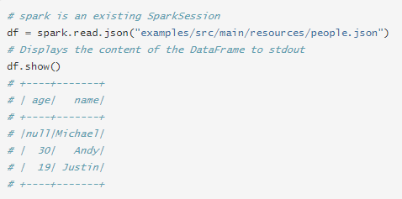
PYTHON
With a SparkSession, applications can create DataFrames from an existing RDD, from a Hive table, or from Spark data sources.
As an example, the following creates a DataFrame based on the content of a JSON file:

Slide 16
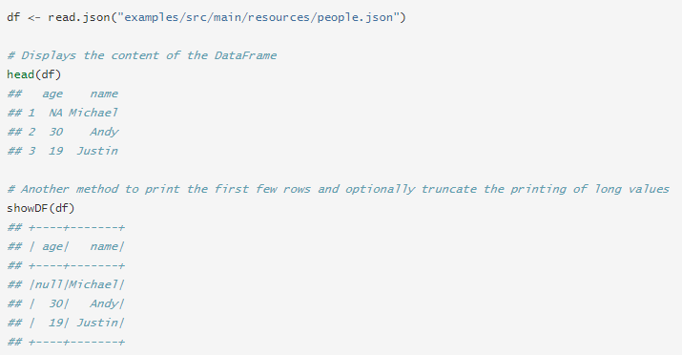
R
With a SparkSession, applications can create DataFrames from a local R data.frame, from a Hive table, or from Spark data sources.
As an example, the following creates a DataFrame based on the content of a JSON file:

Slide 17
Limitations of DataFrame
Spark SQL DataFrame API does not have provision for compile time type safety.
So, if the structure is unknown, we cannot manipulate the data.
Once we convert the domain object into data frame, the regeneration of domain object is not possible.

Slide 18
Conclusion
DataFrame API in Spark SQL improves the performance and scalability of Spark.
It avoids the garbage-collection cost of constructing individual objects for each row in the dataset.
The Spark DataFrame API is different from the RDD API because it is an API for building a relational query plan that Spark’s Catalyst optimizer can then execute.
This DataFrame API is good for developers who are familiar with building query plans. It is not good for the majority of developers.

Slide 19
END OF SESSION
Q&A

